Slide 1
Contract Insights (SOW)
KEY Information extraction using Generative AI
Save time and effort by easily extracting what matters most

Slide 2

Business Case for Contract Document Intelligence
Objectives: Contract Insights Intelligence (SOW) using Generative AI to speed up the key information extraction process, manage the central database and visualize Contract Insights through a Dashboard
Contract Document
Power BI Dashboard
Benefits
Reduce Error and increase speed with automated processing
Search compliance terms thereby reducing risk
Ease of comparing & and negotiating contracts
Helps in re-usability of common steps while creating new procedure
Better user experience by providing digitized content in a web page or mobile app
Ease Of Locating Documents for carrying out procedures corresponding to assets
Reduce the time and effort in creating new procedure
Identification of Decision points
Mapping procedure documents with assets and location information
Classification of documents based on different files & and content formats

Slide 3

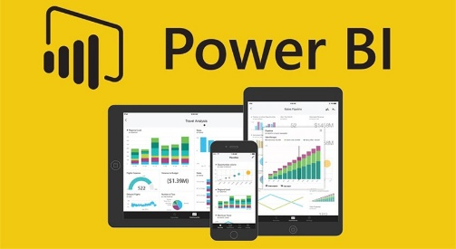

Solution Design for Contract Insight Project
INPUT
GENERATIVE AI
Hosting on Azure
OUTPUT
Text Splitter
Text Splitter
Chunks
Embedding Generator
Pinecone Vector Database
Embedding Generator
Query
Query
Sentence Transformers
Contract Document (SOW)
Query + Context
Query + Context
Visualizing Contract insights through Power Bi Dashboard
Embeddings
QnA Model
QnA Model
Relevant Docs
Answers
Answers

Slide 4
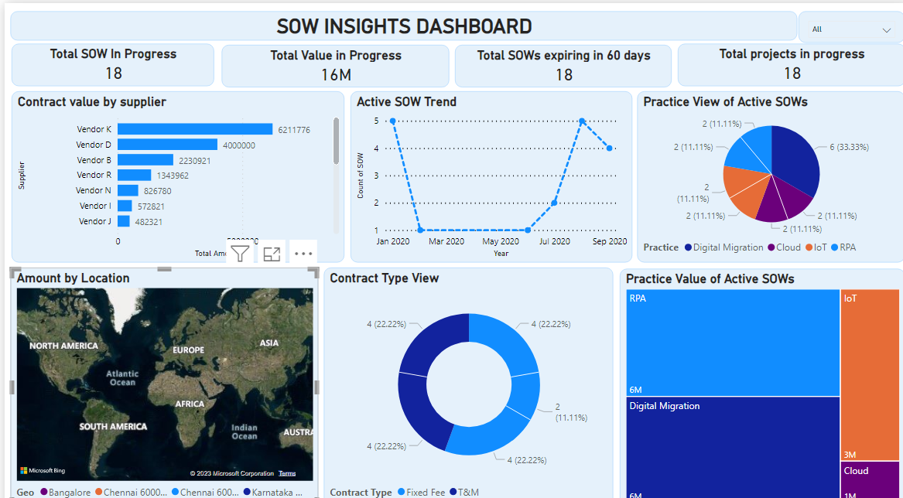
Intelligent Document Processing (Dashboard Intelligent Insights)
Details of the total number of projects in progress
Amount by Location Utilizes a Map Chart to show the total amount by location

